Slide 1
Musical Instrument Identification Using Convolutional Neural Networks
RuiHengZhang

Slide 2

Introduction
In this project, we designed a convolutional neural network model to classify musical instruments from a collection of audio samples of each instrument.
Motivation:
Everybody loves music. It is sometimes difficult for humans to identify musical instruments by ear. Wouldn’t it be great if we have a computer program that can do that for us?
It is interesting to see a computer program that is able to identify the sound of each musical instrument. It will serve helpful for when people search for specific instrumental musics.

Slide 3

Applications
Music recommendations
Personalize tags on different users
Search by sound similarity

Slide 4
Datasets
1.Download the data from “https://owncloud.tuwien.ac.at/index.php/s/hivOGXKoUQtacbo”
2.Set path in '/home/data/gtzan_music_speech’
3.Load the file
4. Encode Labels to Numbers
5. Standardization

Slide 5

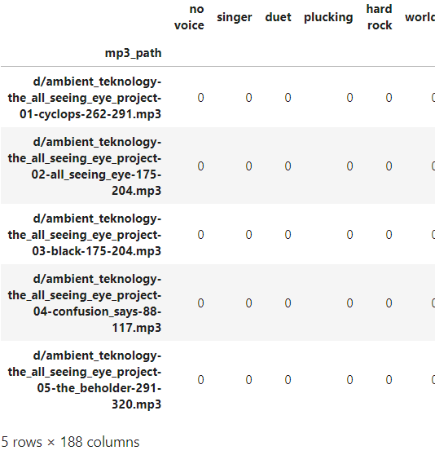
Instrumental vs. Vocal Detection to Instruments Detection
this is a binary classification task (output decision is between 0 and 1)
Create 2 classes from a list of tags
There are plenty of "tags" in this data set which hint at wether a track is "vocal" or "instrumental". We group these tags and finally come up with 1 boolean column saying whether a track is "vocal" or "instrumental".

Slide 6
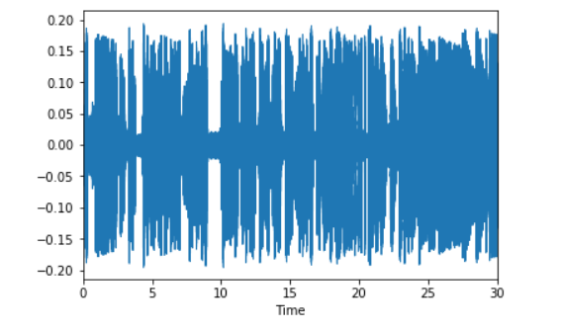
Load the Audio Files
Function to analyze audio files and get small or large spectrogram excerpts
Show Waveform and Spectrogram (just for illustration)
Standardization
Always standardize the data before feeding it into the Neural Network!
We use the StandardScaler from the scikit-learn package for our purpose. As it works typically on vector data, we have to vectorize (i.e. reshape) our matrices first.

Slide 7
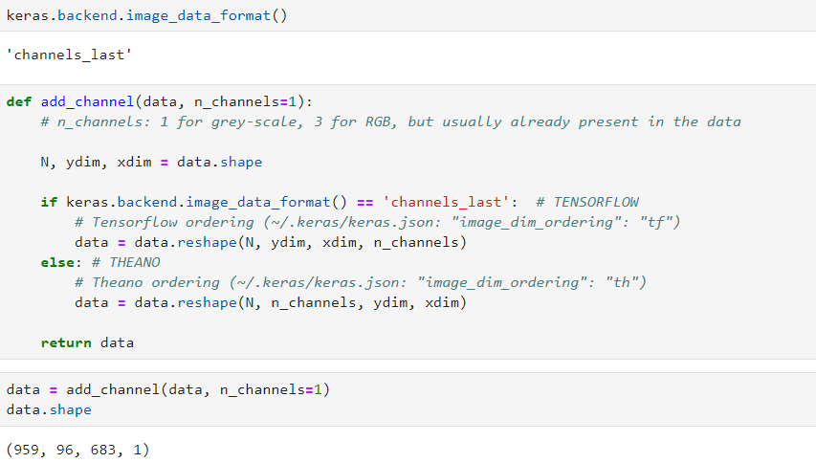
Adding the channel
As CNNs were initially made for image data, we need to add a dimension for the color channel to the data. RGB images typically have a 3rd dimension with the color.
Spectrograms, however, are considered like greyscale images. Likewise we need to add an extra dimension for compatibility with the CNN implementation.

Slide 8
Train & Test Set Split
We split the original full data set into two parts: Train Set (75%) and Test Set (25%).
This is a 5 layer Convolutional Neural Network

Slide 9
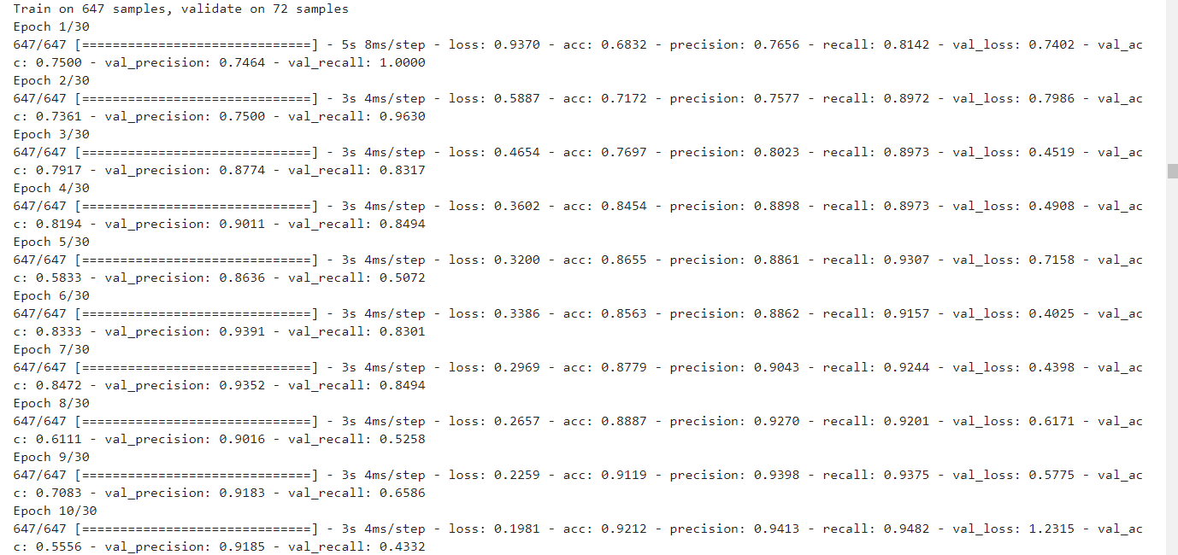
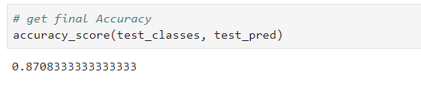
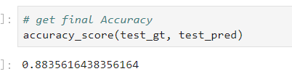
Training results

Slide 10
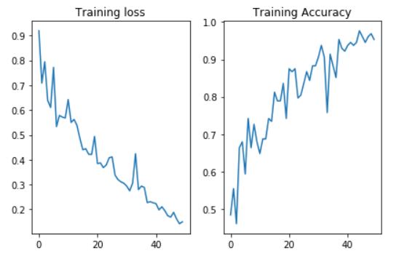
Training Results

Slide 11
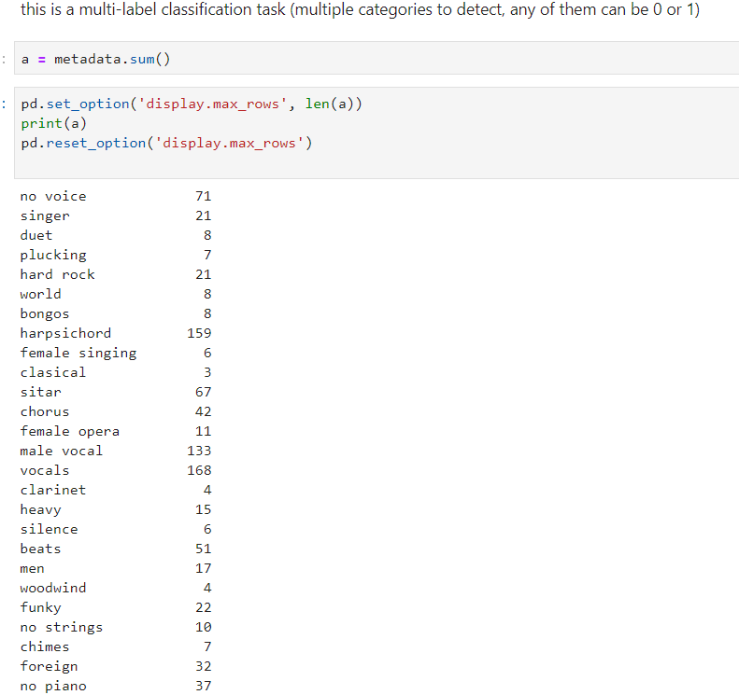
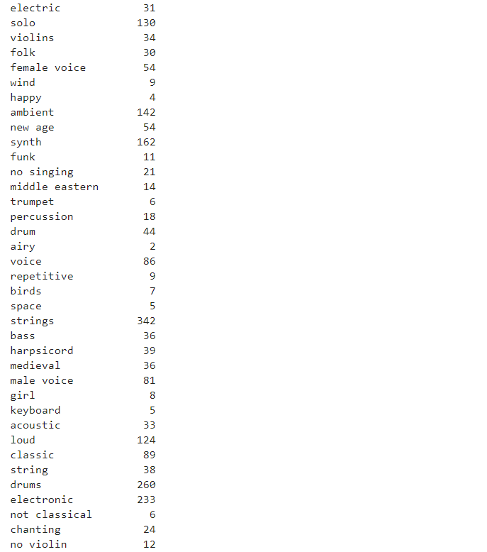
Recognition results

Slide 12
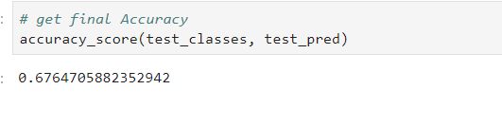
Conclusion
Learned a lot
Limitation& future work
As we involved in Tensorboard the accuracy gets pretty low.

Slide 13

Thank you!

